Slide 4
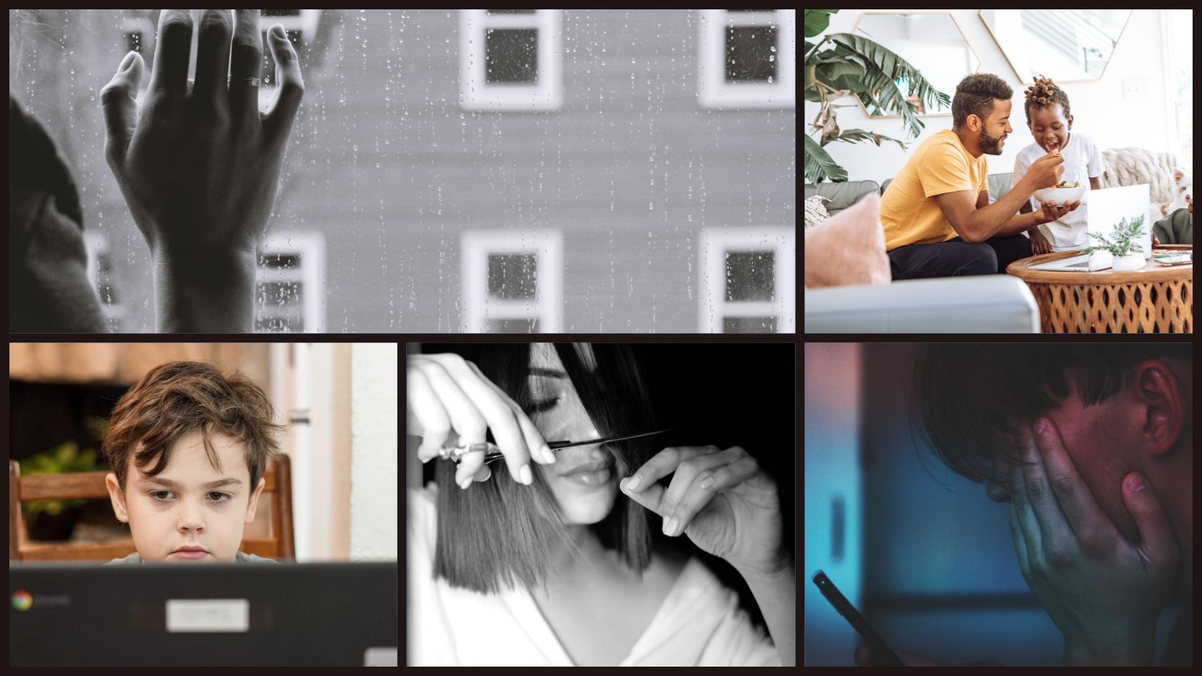
Notes:
What was the pandemic like for our kids? Could've had photos of parents tearing their hair out here (sound familiar anyone?) but trying to think through our children's eyes.....loneliness, boredom, retreat into the world of technology, home haircuts and more sourdough bread than we could ever need! But also points of connection, familiar togetherness, slowing down.....

Slide 5
Notes:
1. What did you notice DURING lockdown? 2. What do you notice NOW?

Slide 6
Notes:
When working developmentally, we must always consider the SYSTEM around the child. COVID impacted all elements of the systems around a child - while there are many other elements I could have included, let's focus on those aspects that the research has examined and for which we have clear evidence. There has been a clear and direct impact of the pandemic on the child, but also on their parents, their teachers and their peers. Specifically....(see next slide)

Slide 8
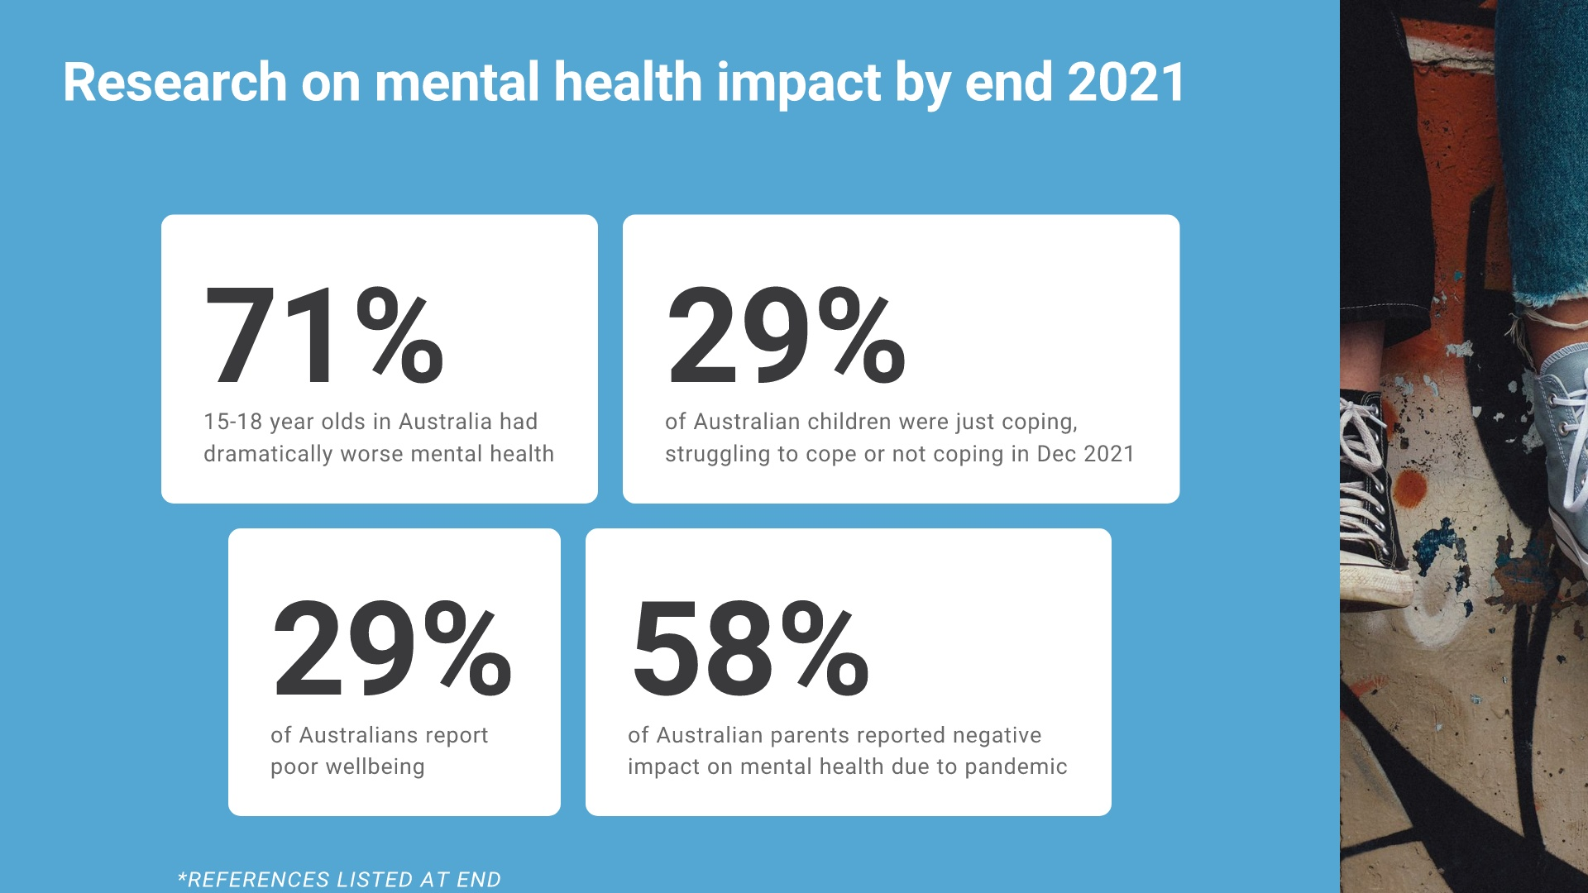

Slide 9
Notes:
NOt to mention of course the impact on social connectedness, feelings of isolation and social skills (primary teachers - any comments on the social skills of early primary aged kids this year?)

Slide 10
Notes:
As with other negative outcomes, issues were even greater for children with additional health care needs (eg. developmental and behavioural needs) BUT some positive for children w/ particular medical conditions such as asthma, reduced cases of influenza, norovirus and possible evidence that there may be reduced incidence of pre-term births.

Slide 12
Notes:
Lower socio-econimic status is a risk factor for many reasons including reduced access to high quality technology during remote learning, , lower education level of parents thus may be less able to help with school work, etc. Interestingly the need for mental health support was found to be equal at BOTH ends of the socio-economic spectrum, the difference is that at the lower end children were far less able to access that support. Screen time - a complex r/ship. MOst studies found that screen time increased exponentially and this was in many studies linked to poorer mental health outcomes. Though depending on age of child and quantity and quality of use, some results indicate that it helped buffer their wellbeing by providing a point of social connectedness.

Slide 13
Notes:
1. Exercise was found to considerably reduce mental distress during COVID-19, AND we know that it can have a direct and profound impact on the mental health of all people, both children and adults. 2. Connection - through talking to others, either in-vivo or via technology. Playing games with their family or even exercising with others such as going for walks or bike rides together. So all those times kids just HAD to facetime their friends was actually worth it! 4. Presence of siblings was found to be a protective factor for infants (maybe not for older kids because of the constant fighting like cats and dogs?) 6. Sleep - if you have a teenager at home you might be laughing now, because don't they get more than enough sleep anyway?! But sleep was one of the factors that was significantly affected for many YP during lockdowns and is a huge protective factor against a multitude of physical and mental health concerns.

Slide 15
Notes:
Connect - we know one of the protective factors during the pandemic was social connectedness and this is generally shown to be a protective factor against all kinds of negative outcomes, including mental health issues. So spending time on re-building that connection is absolutely VITAL for these children and young people. And without the connection, not only may their mental health suffer, but their motivation for learning is likely to be reduced. Communicate - this may need some creativity to find ways to communicate more with parents/caregivers. If we notice something different about one of our students we need to speak up, find out from family if there have been any changes recently or what's going on at home. Talk to student themselves. Remember, what may look look anger or boredom may well be underpinned by anxiety, or may be withdrawal due to feelings of depression. Be flexible - when young people suffer from anxiety or other mental health challenges, they NEED FLEXIBILITY. Talk to parents/caregivers about what accommodations will help them. Not just flexibility with due dates, and how they participate but ways to accommodate their needs within the classroom. Eg. exit cards Be predictable - not suggesting strict rigid routine here, but rather some general structure to the sessions. If they know what's coming they can mentally 'steel' themselves and this will help maintain motivation to 'get through it'. Allow some control - when anxious feel out of control, thus YP crave more control. No, don't let them take over the classroom! Find ways to give choices and to provide YOU with feedback about what they need. Regulation - again, communicate w/ YP and caregivers. Each person's regulation strategies are different. Find out what works for them. Some ideas include: Sensory strategies Quiet space/corner Allowing use of headphones if classroom feels overwhelming Allowing doodling or mindful colouring while still listening to teaching

Slide 16
Notes:
Meaningful choices - allowing children choices in their learning, such as choice of topics, texts to read or ways to present their work boost their self-efficacy and motivation. Roughly 3 - too few or too many choices can backfire! Feedback - positive feedback as we know is so important to show children what and when they are doing well. Constructive feedback is equally as important to help them learn and grow. BUT there is a difference between constructive feedback and GRADES. If your aim is to build motivation, there should be less emphasis on numerical grades or competition and a greater emphasis on MASTERY. Providing rationale - this includes providing a rationale for each topic or assignment. It also includes helping students to make their own personal connections with the learning. Growth mindset - helping students focus on EFFORT over OUTCOME. Over 30 yrs ago, Carol Dweck and colleagues became interested in students' attitudes towards failure. Some students could bounce back from failures, while others seemed devastated by even the smallest events. This led to research on how these different groups of students' mindsets may impact on their motivation to learn and persevere.

Slide 18
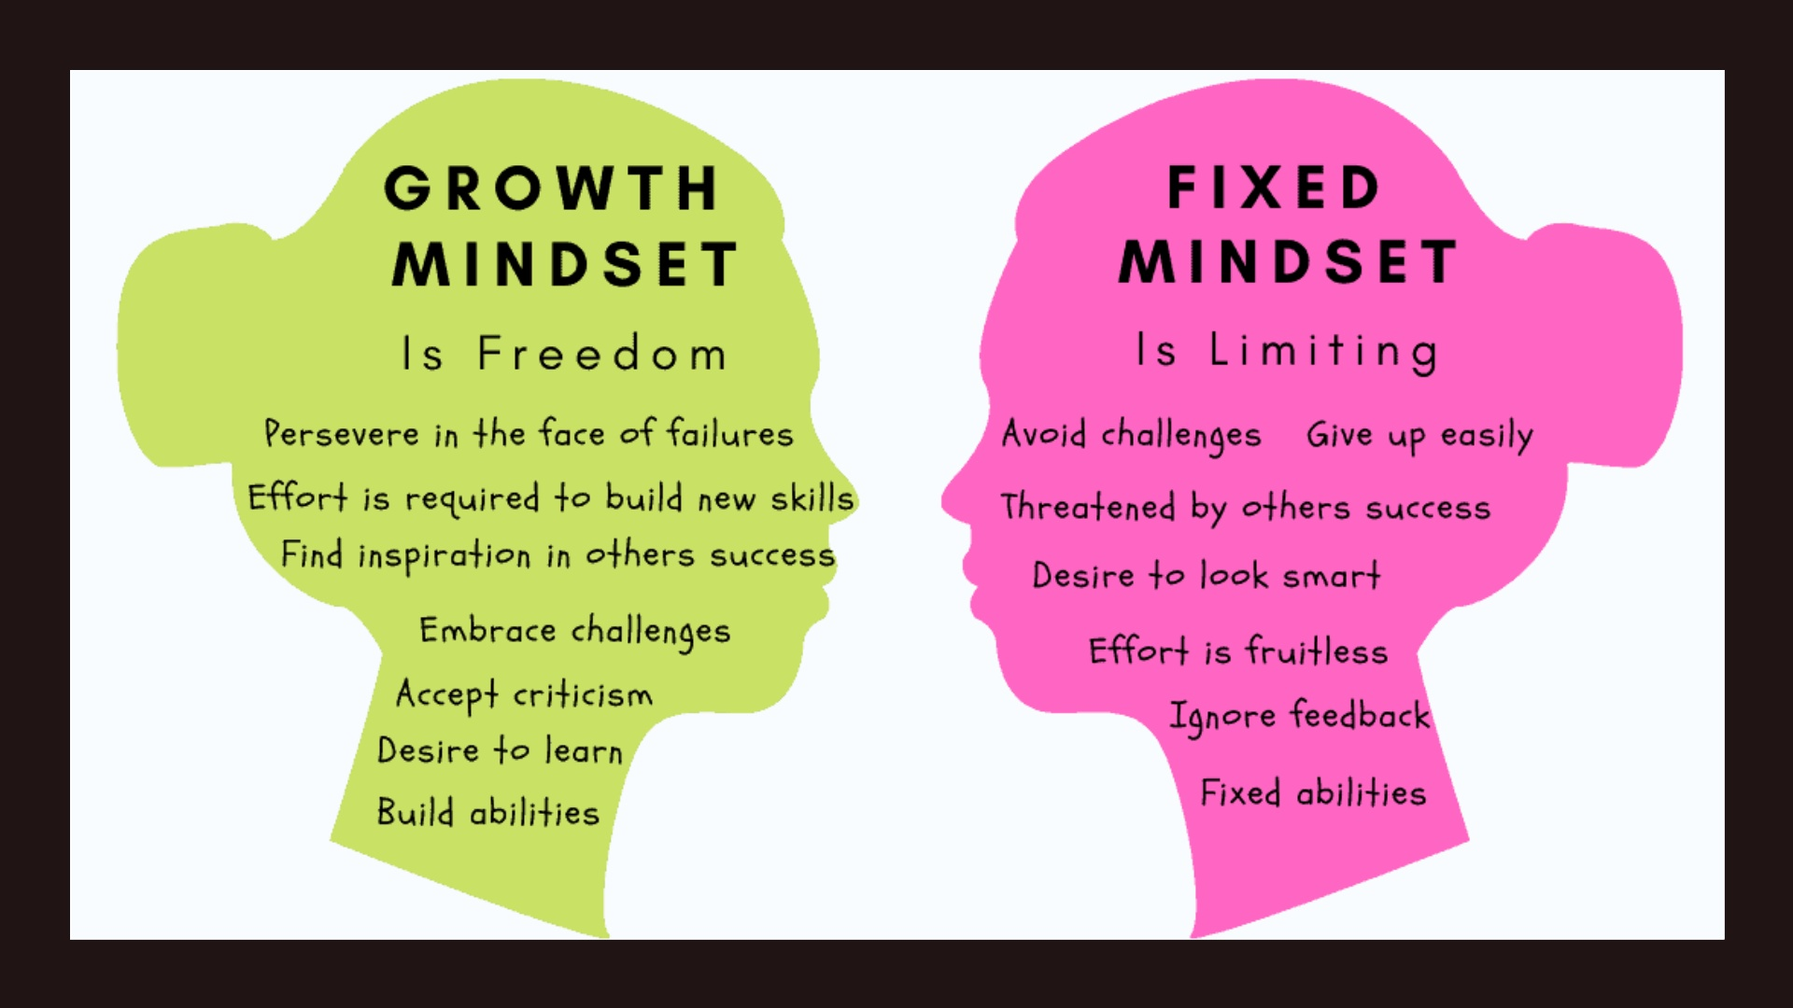

Slide 19
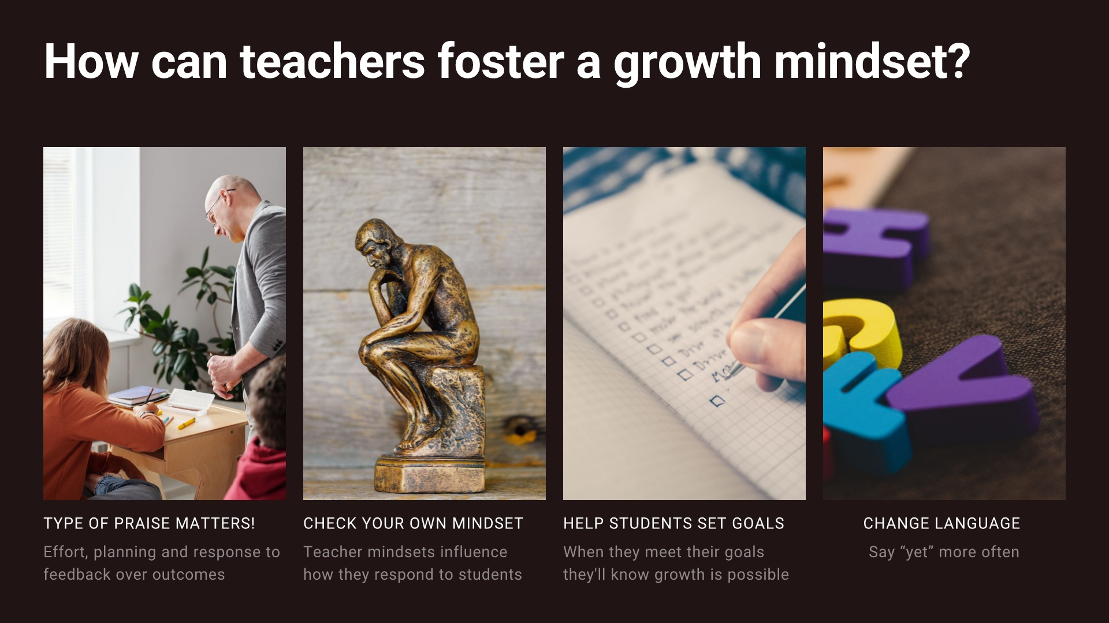
Notes:
PRAISE MATTERS: Research has shown that simply praising intelligence or even sheer effort is LESS effective in building motivation for challenge. Students who were praised for intelligence avoid challenging tasks whereas those praised for effort opted to progress to more difficult tasks. When students were praised for having high ability, they came to attribute their success to a fixed (and unchangeable) quality of themselves, while students praised for effort believed that their performance was subject to improvement. CHECK YOUR MINDSET: In a 2012 study, researchers found that educators with a fixed mindset about math ability were more likely to judge students as having low potential than their growth-minded counterparts. HELP STUDENTS SET GOALS: Set learning goals for themselves and then help them work out how to progress towards meeting these goals. CHANGE LANGUAGE: Instead of "I can't do it", " I can't do it YET" - "I can't remember it YET"....etc.

